Slide 1
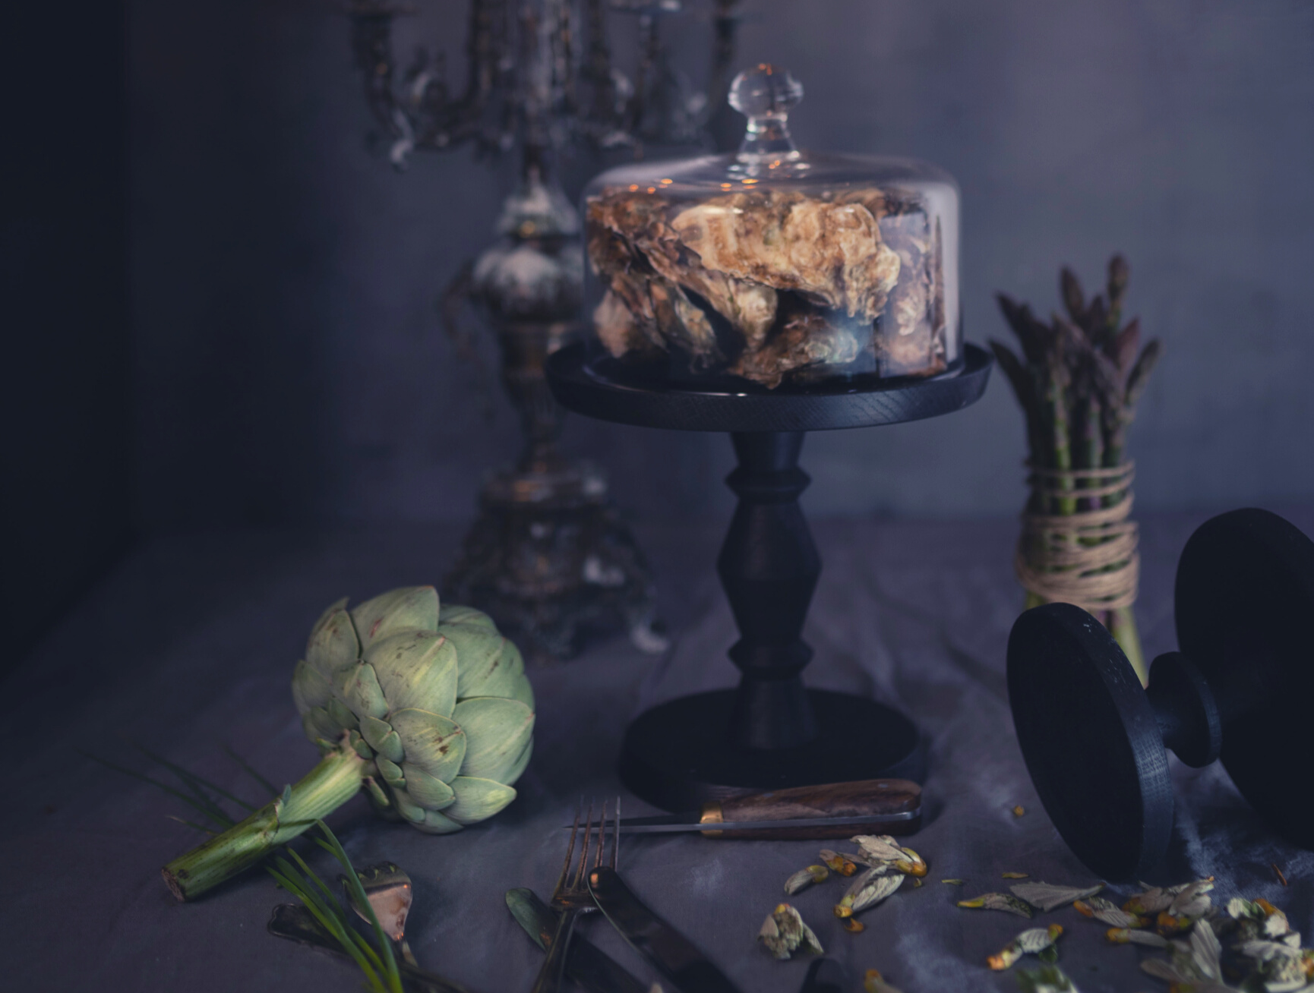
COVID19 AND BEYOND
Our dedication to your safety
Have a great time and a
SAFE STAY

Slide 2
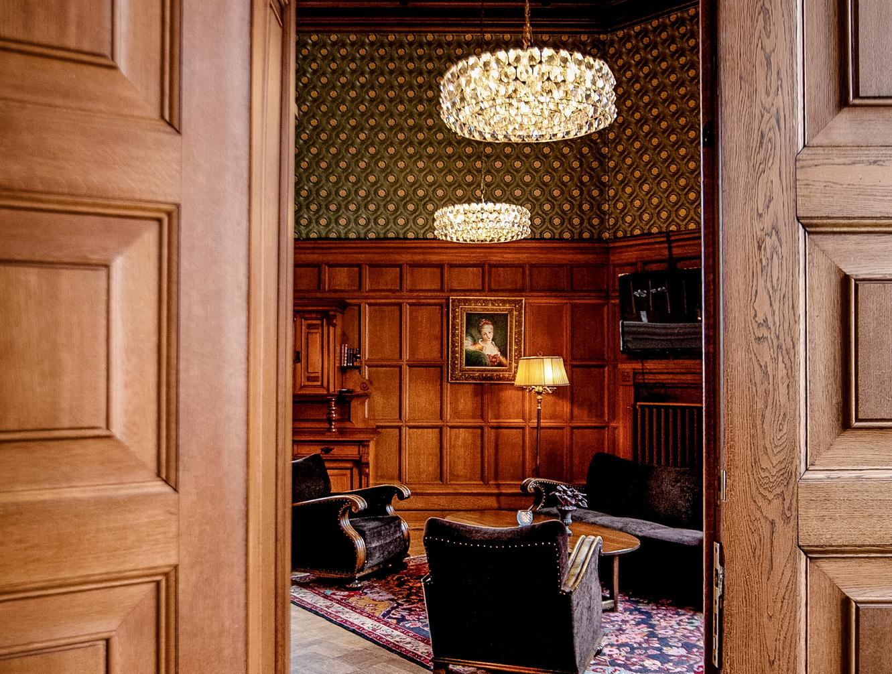
WELCOME TO THE NEW NORMAL!
At Örenäs Slott, our priority is the safety and wellbeing of our guests and team members. Besides our regular high service standards and the authority's recommendations, we have created our own reinforced guidelines summarized in this brochure. Our secluded, beautiful surroundings further give our guests possibilities for a relaxing, comfortable, and Safe Stay.
We hope this can reassure you about our dedication to make your meetings and your stay here as safe and as pleasant as possible.
Looking forward to welcoming you to our hotel soon.
Mikael Petersson
CEO, Örenäs Slott
Note that the content of the brochure can be changed over time in accordance with the situation and authorities' recommendations and restrictions

Slide 3
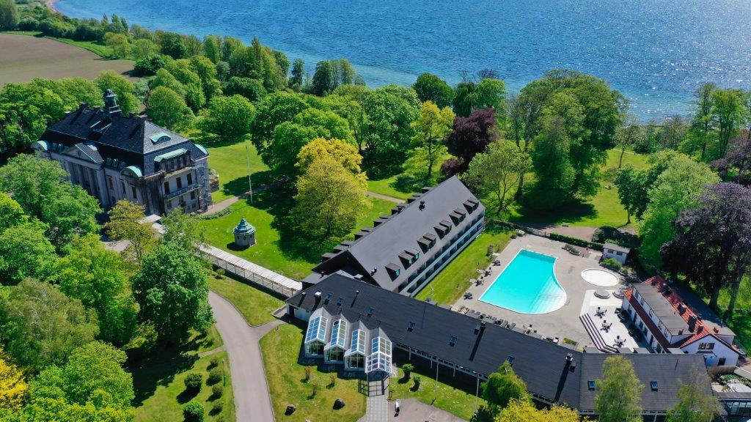
Our secluded, beautiful surroundings further give our guests possibilities for a relaxing, comfortable, and Safe Stay.

Slide 4
SOCIAL DISTANCING
& PUBLIC AREAS
We have seven acres of beautiful castle park surrounding our hotel, which allows for easy and relaxing social distancing and a safe time together.
Our car park is large and spacious, allowing for easy access in and out of our facilities.
All entrance points to our buildings have stations with hand-sanitizers.
We have clear signage and floor markings in each building promoting social distancing and hygiene.
Our guest lifts are prioritized for our guests with accessibility needs, have clear signage of maximum number of guests, and are regularly cleaned. Outside lifts we provide hand-sanitizers.
All public toilets have hand-sanitizer available and are cleaned regularly.
Outside public toilets, signage is posted stating maximum number of guests at the same time.
Group registrations are allocated to separate areas to limit crossover between events.
Our public areas are spacious in all buildings, and if required we have large outdoor spaces that can be used for waiting & mingling without overcrowding.
First Aid kits are available in all buildings. Defibrillator is available by the reception in the hotel building.
Staff is regularly trained in fire procedures and CPR. We have also introduced specialized training in hygiene.

Slide 5
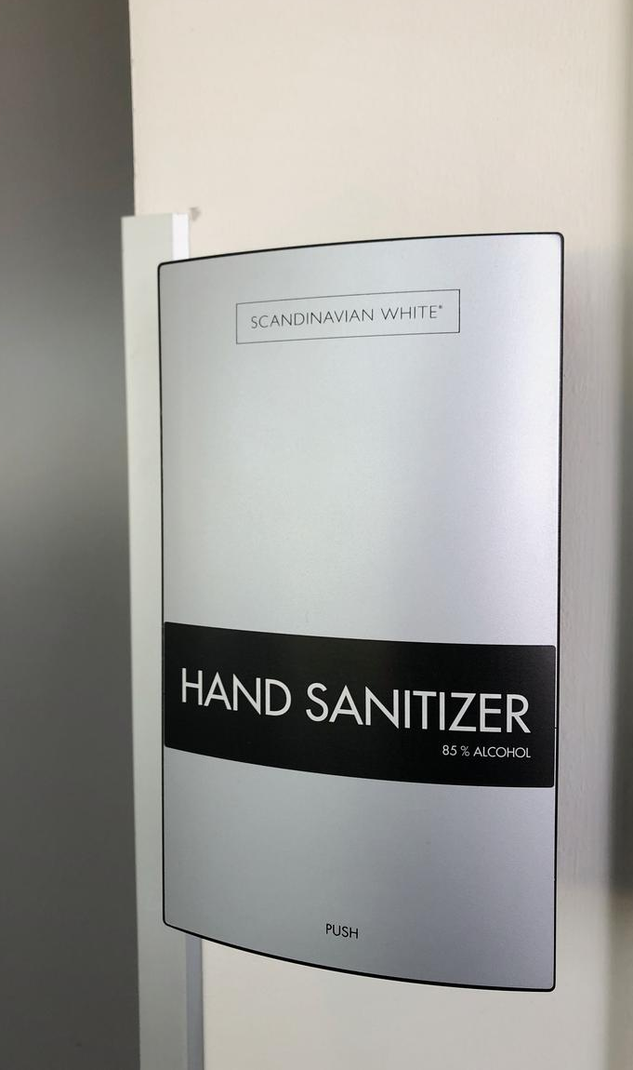
RECEPTION
& LOBBY AREA
We provide hand-sanitizing stations for all guests by all entrance points of the hotel.
Our reception team cleans and sanitizes the reception desk on regular basis.
We utilize UV Light Disinfectant Box with CE Certification to disinfect our key cards and pens. This box can also be used by our guests to sterilize their phones etc.
Reception is fitted with plastic screen between our receptionists and our guests.
Our hotel is cashless to avoid unnecessary contact points.
Card payment devices are wiped down regularly with antibacterial wipes.
Our Housekeeping team cleans the lobby area regularly, with focus on door handles, buttons, bannisters, and other areas of contact.
Public toilets are provided with hand-sanitizers and are cleaned regularly.
Signage posted outside toilets stating maximum number of guests allowed inside at the same time.
Clear signage and floor markings posted throughout our facilities promoting social distancing and hygiene.
Our guest lifts are prioritized for our guests with accessibility needs, have clear signage of maximum number of guests, and are regularly cleaned. Outside lifts we provide hand-sanitizers.
Group registrations are allocated to separate areas to limit crossover between events.
Individual check-ins are recommended to be done by one family member to avoid queues.

Slide 6
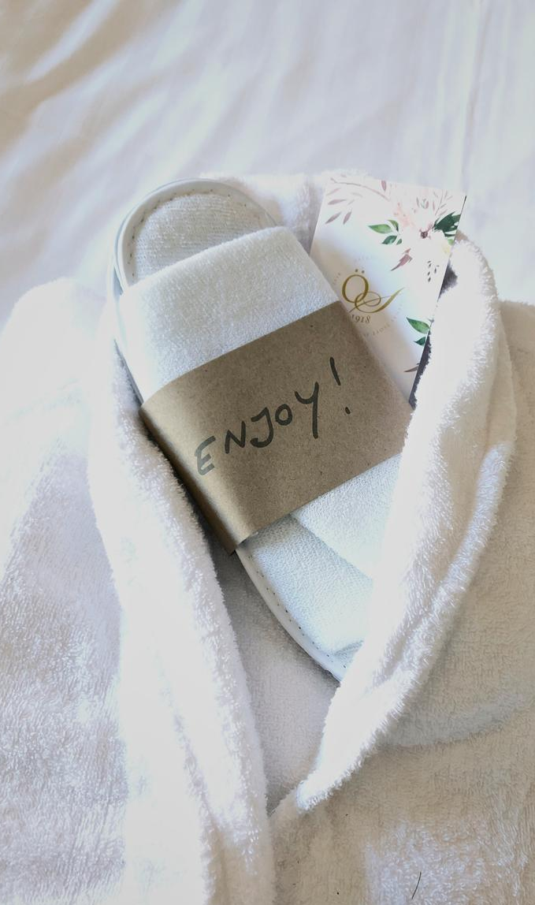
HOTEL ROOMS
We clean and sanitize bedrooms between bookings. The enhanced cleaning procedure include focusing on common touch points: switches, doorknobs, remote controls, kettles, minibar items etc.
We have added UV lights in our cleaning procedure as an extra measure of sterilization – The lights are placed in the bathroom and the by the desk area.
We have removed certain common touch point items from the room, I.e. In Room directory, menus, magazine. These are available on request.
Glasses and cups are sterilized by UV light in rooms. Commercial dishwasher is used to clean dirty dishes and glasses
We have removed stationary from the rooms. Available on request.
We have removed throw pillows and bedspreads from all our standard rooms. In our other room categories, we have limited the number of throw pillows and spreads.

Slide 7
FITNESS
& WELLNESS
Our pool area has clear signage promoting distance between sunbathers. When required, we also extend the relaxation area to include the castle park to avoid overcrowding.
The water quality in our pool and hot tubs are checked daily, and every month water samples are sent to authorities for inspection.
We have introduced max seating capacity in our hot tubs & saunas, indicated on clear signage.
Our gym is equipped with signage and sanitation stations for both hands and equipment. We also have an outdoor gym in the park with plenty of space.
In our castle park you can play minigolf, boule, croquet, and other games. The equipment is wiped down after every use.
There are two running paths adjacent to the park: 2,5km and 7km – maps available in the reception
Fun quiz for adults & kids are available in the park – answer sheets and pens can be collected in the reception.
The park is well suited for relaxation, walks, yoga etc.
The beach and the fishing village Ålabodarna is only three minutes’ walk thru the castle park

Slide 8
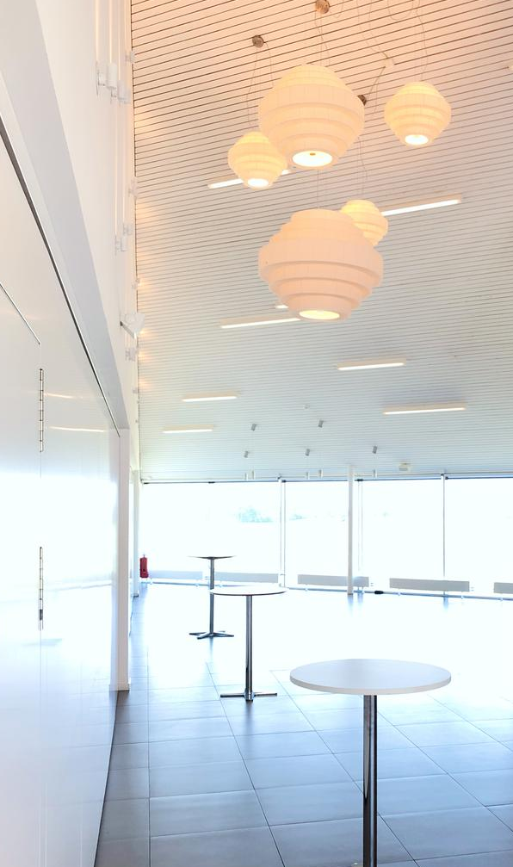
CONFERENCE
During the situation with Covid-19, we have introduced flexible and beneficial cancellation policies for all types of bookings. Please contact bokning@orenasslott.com for more information
We are equipped for digital and hybrid meetings, utilizing modern and easy-to-use technology that can be pre-booked.
We have large and spacious facilities, both indoor and outdoor, enabling comfortable and airy meetings.
With 26 conference rooms of various sizes, we can accommodate several groups without risking a crowded environment.
The seating capacity in our conference rooms is reduced by more than 50% which ensures spacious and safe environment for meetings.
We can also recommend utilizing our beautiful outdoor surroundings for walk & talk, and any type of outdoor meeting when the weather allows.
Our conference rooms are wiped down & cleaned after each group, with focus on surfaces, technical equipment, doorknobs etc. Table are left clear of pads and
Sterilized markers, pens,pads and high lighters for whiteboard/flipcharts are available from the Conference host.
Coffee breaks are divided in several locations as required. Floor markings and clear signage posted, as well as hand-sanitation stations.
Lunch & dinners are served at the table. We have reduced our seating capacity in the restaurant by more than 50% to ensure the area is spacious and safe for our guests.

Slide 9
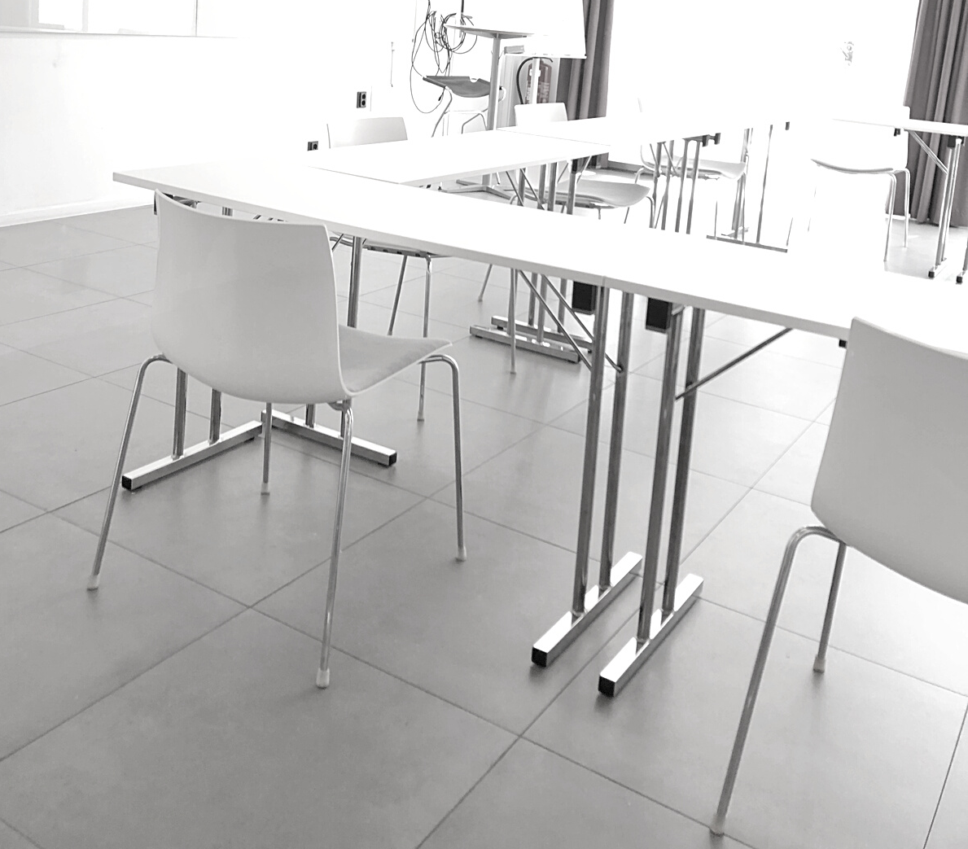
CONFERENCE
The conference building is equipped with clear signage and floor markings. Hand sanitation stations in several areas.
All conference rooms are equipped with hand sanitizer
All toilets in the conference building has hand sanitizer, and are cleaned regularly throughout the day
We have several options for breakout rooms where guests can sit at a comfortable distance from each other

Slide 10
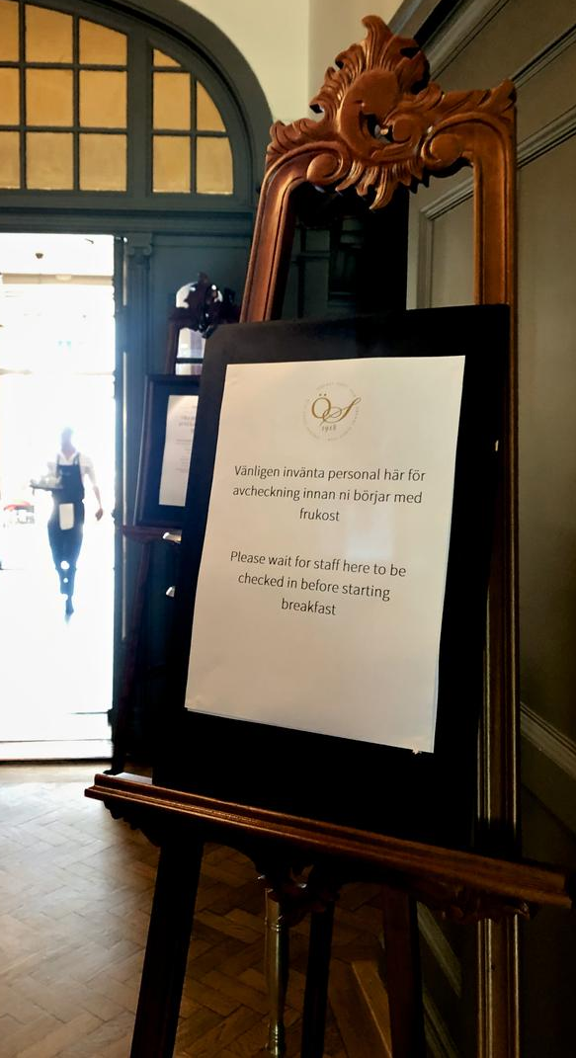
FOOD
& BEVERAGE
Seating capacity in the restaurant and our banquet hall have been reduced by more than 50% to ensure a spacious area for our eating guests.
Breakfast is served on buffet. The buffet area has been limited to 10 guests at any one time (floor markings and signage posted) with designated entrance and exit points. By the entrance there is hand-sanitizer and plastic gloves provided for our guests. Bread is served at the table to avoid queuing.
At check-in we allocate breakfast times for our guests and spread them evenly throughout the breakfast opening hours – this ensures a spacious and safe breakfast environment
Breakfast cutlery is folded in napkin-pockets to avoid unnecessary touching.
For our guests who prefer not to eat from our breakfast buffet, we offer breakfast bags to take away to your room, or perhaps to the park in the summertime. Breakfast bags can be booked at check-in.
Thanks to our large spaces we can also set up double buffets if this is required.
Kitchen is equipped with several hand-washing stations, hand-sanitation stations, and plastic gloves
Our kitchen team is trained in hygiene and the kitchen is regularly inspected by relevant authorities.
The food on our menus is available as take away.
Our food suppliers are certified by respective authority regarding hygiene and quality

Slide 11
For more information or to make a booking please contact:
info@orenasslott.com
+46 (0)418 451100

